Slide 1
Water Quality Prediction
20B01A1294
Maddu Geetha Naga Durga Lahari

Slide 2
Problem Statement
In this WATER QUALITY PREDICTION PROJECT , we are going to develop an online-based system to analyse the quality of water (safe or unsafe)
In this technique, our model predicts whether the water is safe to drink or not, by using some parameters like PH value, Conductivity, Hardness, etc..,

Slide 3
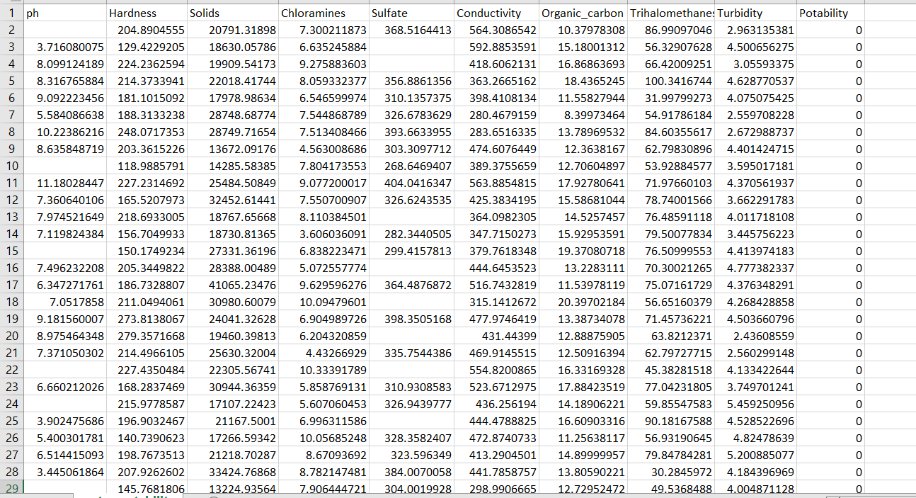
Dataset
In this project we are considering a dataset which consist of more than 3000 plus water samples and there respective parameters that are required for prediction.

Slide 4
Attributes of dataset and their optimal range
PH – neutral range( 6-7 )
Hardness – low range
Solids – 500 to 1000 mg/l
Chloramines – low range (<4 mg/l)
Sulfate – low range (<250 mg/l)
Conductivity – very less (insulator)
Organic carbon – low (<2 mg/l)
Trihalomethanes – low (<80 ppm)
Turbidity – 5 to10 ppm
Potability – 1 (Safe to drink) or 0 (Unsafe to drink)

Slide 5
Pre - Processing
Data preprocessing is an essential task for cleaning the data and making it suitable for machine learning model which increases the accuracy and efficiency of the model.
In this dataset some of the parameters like PH, Sulfate, Trihalomethanes contains missing values.
We can handle these missing values by filling it with mean value of the each feature in the dataset.

Slide 6
Algorithm LOGISTIC REGRESSION
Logistic Regression Algorithm is applicable for this problem.
Logistic regression predicts the output of a categorical dependent variable. Therefore the outcome must be a categorical or discrete value.
It can be either Yes or No, 0 or 1, true or False, etc. but instead of giving the exact value as 0 and 1, it gives the probabilistic values which lie between 0 and 1.

Slide 7
Thank You

